Slide 1
Strings in Java (Algorithms and Data Structures)

Slide 2
Strings
Strings are a sequence of characters and they are treated as an object. We can create and manipulate strings with the String class.
By string literal
String name = "Kevin";
By new keyword
String name = new String("Kevin”);

Slide 3
Strings
Since strings are everywhere in Java and they need a lot of memory. Many strings repeat in the program and to solve this issue it’s good idea to reuse common ones. The string constant pool (also known as the intern pool) is a location in the JVM that collects all these strings.
STRING CONSTANT POOL
String Constant Pool (SCP) is a special memory area in
the heap memory
HEAP

Slide 4
Strings
Each time you create a string literal the JVM checks the constant value and the String Constant Pool first
String n1 = "Kevin";
reference variable
constant value
STRING CONSTANT POOL
HEAP

Slide 5
Strings
Each time you create a string literal the JVM checks the constant value and the String Constant Pool first
If the constant doesn't exist in the pool a new string
instance object is created and placed in the pool with the value of the new string
String n1 = "Kevin";
reference variable
constant value
STRING CONSTANT POOL
Kevin
HEAP

Slide 6
Strings
Each time you create a string literal the JVM checks the constant value and the String Constant Pool first
If the constant doesn't exist in the pool a new string
instance object is created and placed in the pool with the value of the new string
String n1 = "Kevin";
String n2 = "Kevin";
If the string with the same value
already exists in the pool then JVM
will not create a new object
but will return the reference
to the same instance.
JVM NEVER CREATES DUPLICATE
OBJECTS IN THE STRING POOL
STRING CONSTANT POOL
Kevin
HEAP

Slide 7
Strings
Each time you create a string literal the JVM checks the constant value and the String Constant Pool first
If the constant doesn't exist in the pool a new string
instance object is created and placed in the pool with the value of the new string
String n1 = "Kevin";
String n2 = "Kevin";
String n3 = new String("Kevin");
STRING CONSTANT POOL
Kevin
because of the new keyword the JVM
creates a new string object at
runtime in the normal
(non-pool) heap memory
and the reference variable will be
pointing to this object.
Kevin
HEAP

Slide 8
Strings
String n1 = "Kevin";
Notice that only the values are the same, but the reference variables are pointing to different objects!
String n2 = "Kevin";
String n3 = new String("Kevin");
STRING CONSTANT POOL
Kevin
Kevin
HEAP

Slide 9
Strings
String n1 = "Kevin";
String n2 = "Kevin";
String n3 = new String("Kevin");
STRING CONSTANT POOL
String n4 = new String("Kevin");
Kevin
Kevin
because of the new keyword the JVM at runtime creates another new string object
in the heap memory even though
the values are the same
Kevin
HEAP

Slide 10
Strings
String n1 = "Kevin";
String n2 = "Kevin";
String n3 = new String("Kevin");
STRING CONSTANT POOL
String n4 = new String("Kevin");
Kevin
String n5 = new String(„Peter");
Kevin
Kevin
HEAP

Slide 11
Strings
String n1 = "Kevin";
String n2 = "Kevin";
String n3 = new String("Kevin");
STRING CONSTANT POOL
String n4 = new String("Kevin");
Kevin
String n5 = new String(„Peter");
Kevin
Peter
in this case constant value of the new string doesn't exist in the pool so a new string instance is created and
placed in there
Kevin
HEAP

Slide 12
Strings
String n1 = "Kevin";
String n2 = "Kevin";
String n3 = new String("Kevin");
STRING CONSTANT POOL
String n4 = new String("Kevin");
Kevin
String n5 = new String(„Peter");
Kevin
Peter
because of the new keyword the JVM will create a new string object in the heap memory and the reference variable will be pointing to this object.
Kevin
Peter
HEAP

Slide 13
Strings
It is possible that in the future in a java interview, you will be asked a tricky question in the String topic. The question looks simple:
How many string object is getting created in the statement below?
String s = new String("ABC");
Many people give the wrong answer that one object is created in the Heap.
But from now on you will know the right answer that it could be one or two. And it depends on whether the constant value of the new string is already in the String Constant Pool or not.

Slide 14
String Operations (Algorithms and Data Structures)

Slide 15
Strings and StringBuilders
both of these classes have several advantages and disadvantages as well – some efficient operations
Strings are immutable – every time we change the value a new object is created
StringBuilder deals with a sequence of characters so it is mutable
StringBuffer is the same as StringBuilder but it is synchronized so it works fine in multi-threaded environment

Slide 16
Strings and StringBuilders
 | String |  | StringBuilder
 | running time | memory | running time | memory
length() | O(1) | O(1) | O(1) | O(1)
charAt() | O(1) | O(1) | O(1) | O(1)
substring() | O(1) | O(1) | O(N) | O(N)
concat() | O(N) | O(N) | O(1) | O(1)

Slide 17
Suffixes
H
O
U
S
E
SUFFIXES: []

Slide 18
Suffixes
H
O
U
S
E
E
SUFFIXES: [„E”]

Slide 19
Suffixes
H
O
U
S
E
S
E
SUFFIXES: [„E”, „SE”]

Slide 20
Suffixes
H
O
U
S
E
U
S
E
SUFFIXES: [„E”, „SE”, „USE”]

Slide 21
Suffixes
H
O
U
S
E
O
U
S
E
SUFFIXES: [„E”, „SE”, „USE”, „OUSE”]

Slide 22
Suffixes
SUFFIXES
for generating the suffixes
for a given string the
String class is better
because the substring()
method runs in O(1)
running time
H
O
U
S
E
H
O
U
S
E
SUFFIXES: [„E”, „SE”, „USE”, „OUSE”, „HOUSE”]

Slide 23
Prefixes
H
O
U
S
E
PREFIXES: []

Slide 24
Prefixes
H
O
U
S
E
H
PREFIXES: [„H”]

Slide 25
Prefixes
H
O
U
S
E
H
O
PREFIXES: [„H”, „HO”]

Slide 26
Prefixes
H
O
U
S
E
H
O
U
PREFIXES: [„H”, „HO”, „HOU”]

Slide 27
Prefixes
H
O
U
S
E
H
O
U
S
PREFIXES: [„H”, „HO”, „HOU”, „HOUS”]

Slide 28
Prefixes
PREFIXES
for generating the prefixes
for a given string the
String class is better
because the substring()
method runs in O(1)
running time
H
O
U
S
E
H
O
U
S
E
PREFIXES: [„H”, „HO”, „HOU”, „HOUS”, „HOUSE”]

Slide 29
Suffix Tries (Algorithms and Data Structures)

Slide 30
Suffix Tries and String Operations
suffix tries are very similar to tries we have already considered
instead of inserting the key (word) into the tree we insert all the suffixes as well
THIS IS HOW WE GET THE SUFFIX TRIE
most of the string related operations and algorithms have sublinear running time complexity
the first linear algorithm for finding the longest common substring
DNS alignment approaches uses suffix tries heavily

Slide 31
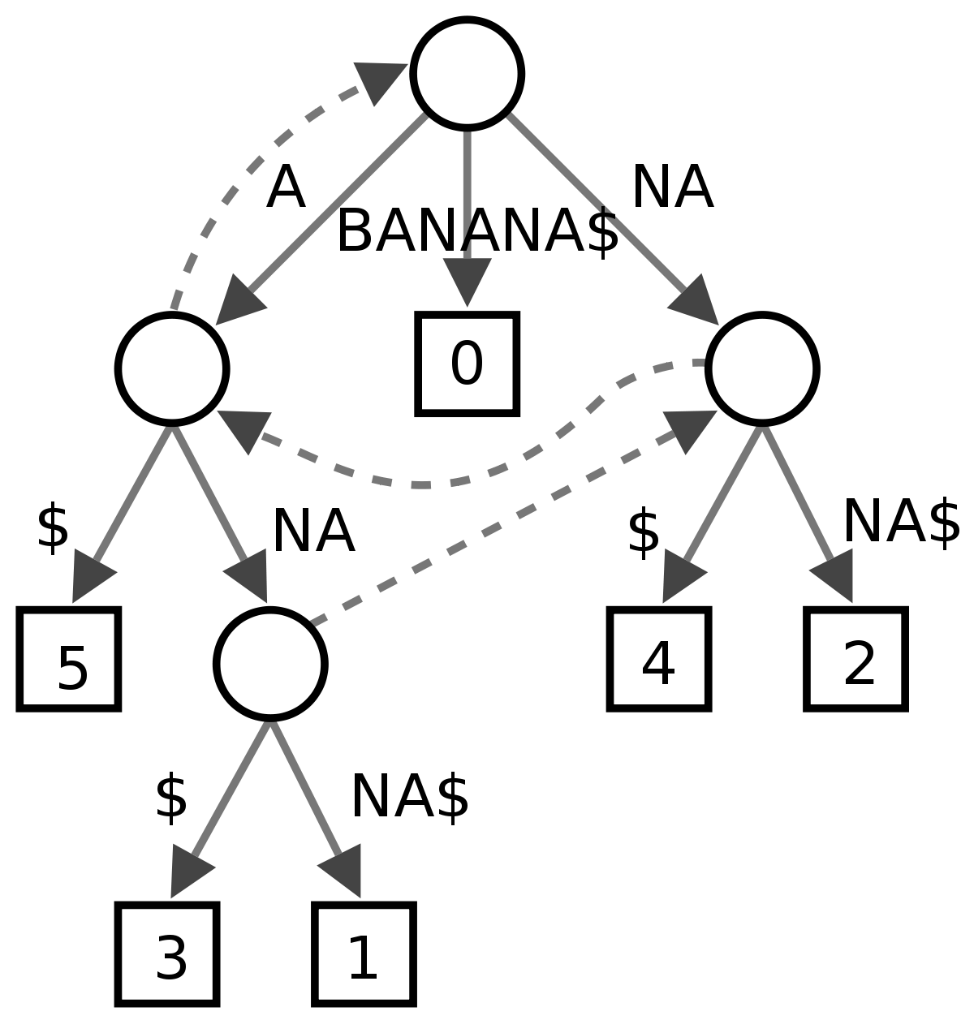
Suffix Tries and String Operations

Slide 32
Suffix Tries and String Operations
back in 1995 an efficient suffix trie construction algorithm was invented by Esko Ukkonen
it is an O(N) linear running time online algorithm – where N is the length of the string
tries are not that memory efficient this is why using suffix arrays are a bit better approach
we can use a simple depth-first search to construct an array from a suffix trie in O(N) linear running time

